Slide 1
Title
Week 1 – Introduction to the module
Dr Fatmaelzharaa Eltaher
Date, Module name, Lesson number
Web Development 1

Slide 2
Contact the Lecturer
Dr. Fatmaelzahraa Eltaher
Email: fatmaelzahraa.eltaher@tudublin.ie

Slide 3
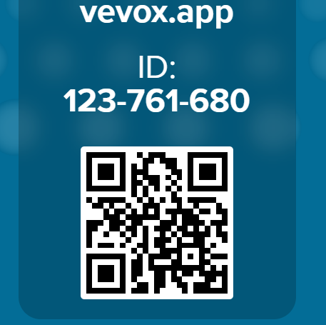
Have you ever tried creating a website before?
Vevox - Present view

Slide 4
Where is the course material?
All lecture notes, tutorials and announcements will be available on Brightspace
Help with Brightspace and how to enrol is available at www.tudublin.ie/brightspace
If you are not able to access the module on Brightspace, please contact the lecturer

Slide 5
Alternative Option
https://github.com/fatmaelther/Web-Development

Slide 6
What we are going to learn?
We’ll learn how to design websites.
You’ll understand how HTML, CSS, and JavaScript work.
We’ll build interactive pages.

Slide 7
Learning outcomes
Describe the underlying architecture of the World-Wide-Web
Describe and employ effective design approaches when building web resources.
Evaluate websites according to well-known criteria for effective web design.

Slide 8
Learning outcomes
Implement web pages using HTML5, CSS3 and JavaScript
Generate web content dynamically and interact with users of web resources using a client-side scripting language such as JavaScript.

Slide 9
Learning approach
The most effective way to learn web technology is to implement systems using those technologies.
Lecture time will be used to provide a high-level explanation of a given technology, with some of its more powerful aspects treated in detail.
Focus is placed on empowering the students to develop their skills independently of the presence of a tutor or lecturer.

Slide 10
How will my learning be assessed?
This module is assessed by:
50% weighting for the examination
50% weighting for the continuous assessment
The continuous assessment marks will be divided over:
6 lab assignments (4 marks each)
Lab attendance: 8 labs × 2 marks each (Lab 1 excluded)
2 lab tests in weeks 6 and 10 (5 marks each)

Slide 11
How will the labs work?
During the lab, your group will choose a client who requests you to develop a website. Your group will work on tasks related to this website over the semester.
Make sure one of the members submits the task on Brightspace according to the deadline.
After submitting, you should present your work to the lab instructor.
Please ensure you submit the correct material, as mixing up files/folders is easy.

